Slide 1
Access Tutorial 1
Creating a Database

Slide 2
Objectives
Define the terms field, record, table, relational database, primary key, and foreign key
Create a blank database
Identify the components of the Microsoft Access window
Create and save a table in Datasheet view
Enter field names and records in a table datasheet
Open a table using the Navigation Pane
New Perspectives on Microsoft Office 2007: Windows XP Edition

Slide 3
Objectives
Open an Access database
Copy and paste records from another Access database
Navigate a table datasheet
Create and navigate a simple query
Create and navigate a simple form
Create, preview, navigate, and print a simple report
Learn how to manage a database by compacting, backing up, and restoring a database
New Perspectives on Microsoft Office 2007: Windows XP Edition

Slide 4
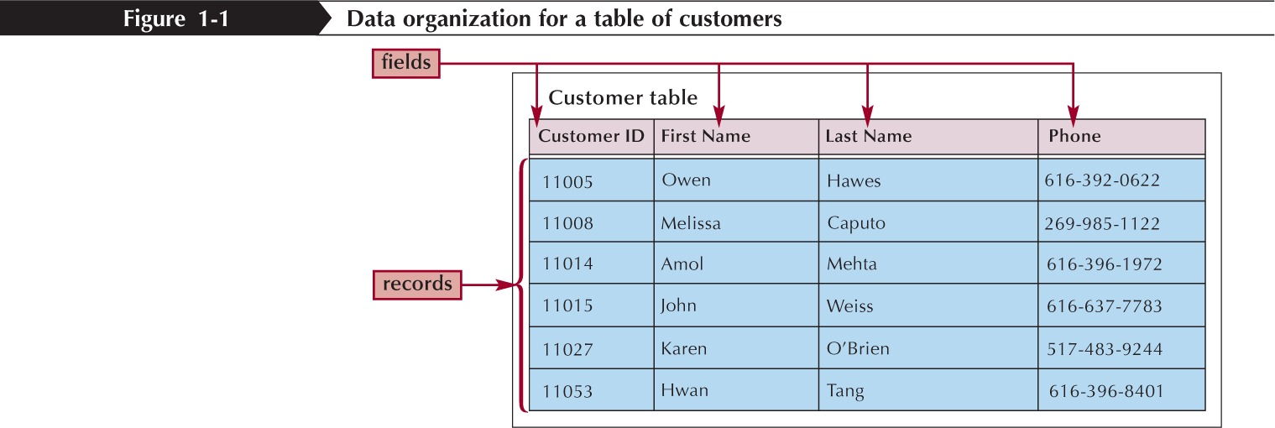
Organizing Data
Your first step in organizing data is to identify the individual fields
  The specific value, or content, of a field is called the field value
  Record
Next, you group related fields together into tables
New Perspectives on Microsoft Office 2007: Windows XP Edition

Slide 5
Databases and Relationships
A collection of related tables is called a database, or a relational database
You connect the records in the separate tables through a common field
A primary key is a field, or a collection of fields, whose values uniquely identify each record in a table
When you include the primary key from one table as a field in a second table to form a relationship between the two tables, it is called a foreign key in the second table
New Perspectives on Microsoft Office 2007: Windows XP Edition

Slide 6
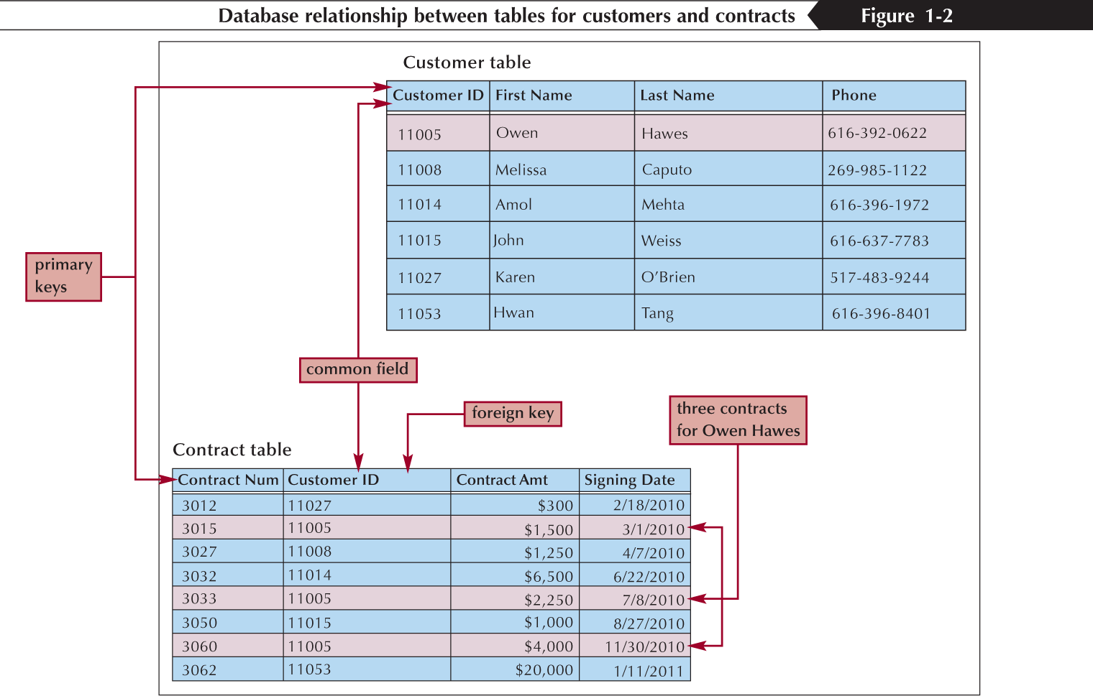
Databases and Relationships
New Perspectives on Microsoft Office 2007: Windows XP Edition

Slide 7
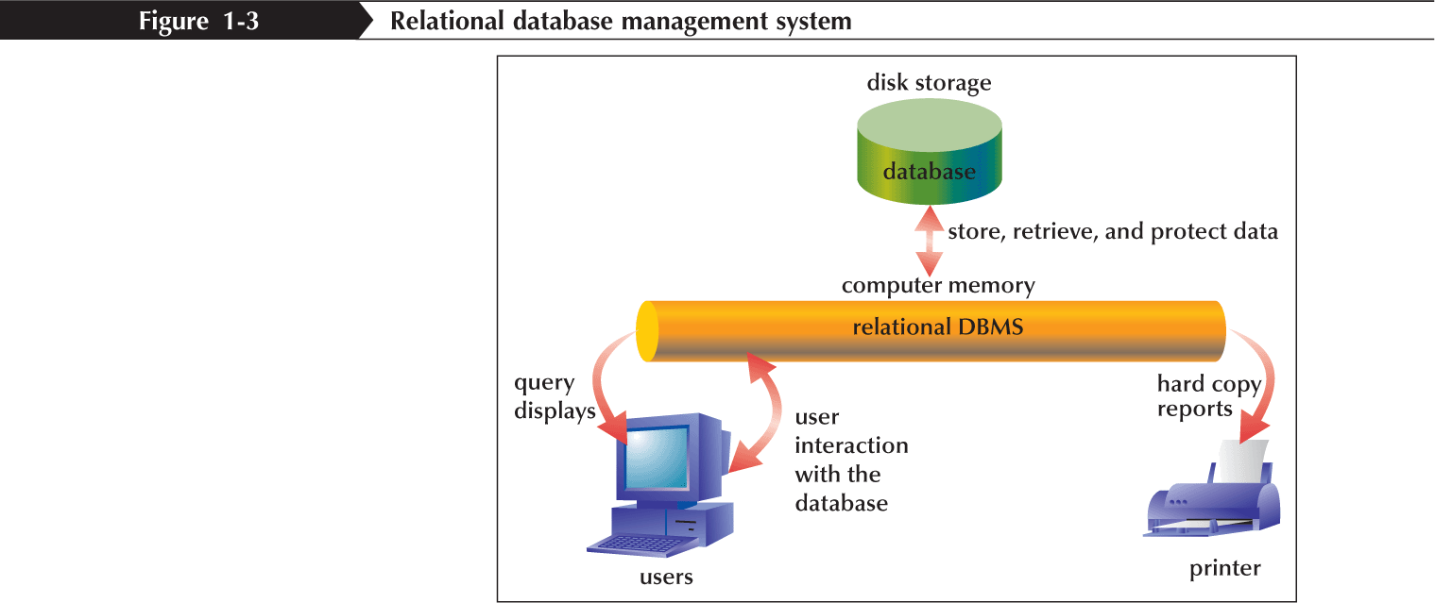
Relational Database
Management Systems
A database management system (DBMS) is a software program that lets you create databases and then manipulate data in them
In a relational database management system, data is organized as a collection of tables
New Perspectives on Microsoft Office 2007: Windows XP Edition

Slide 8
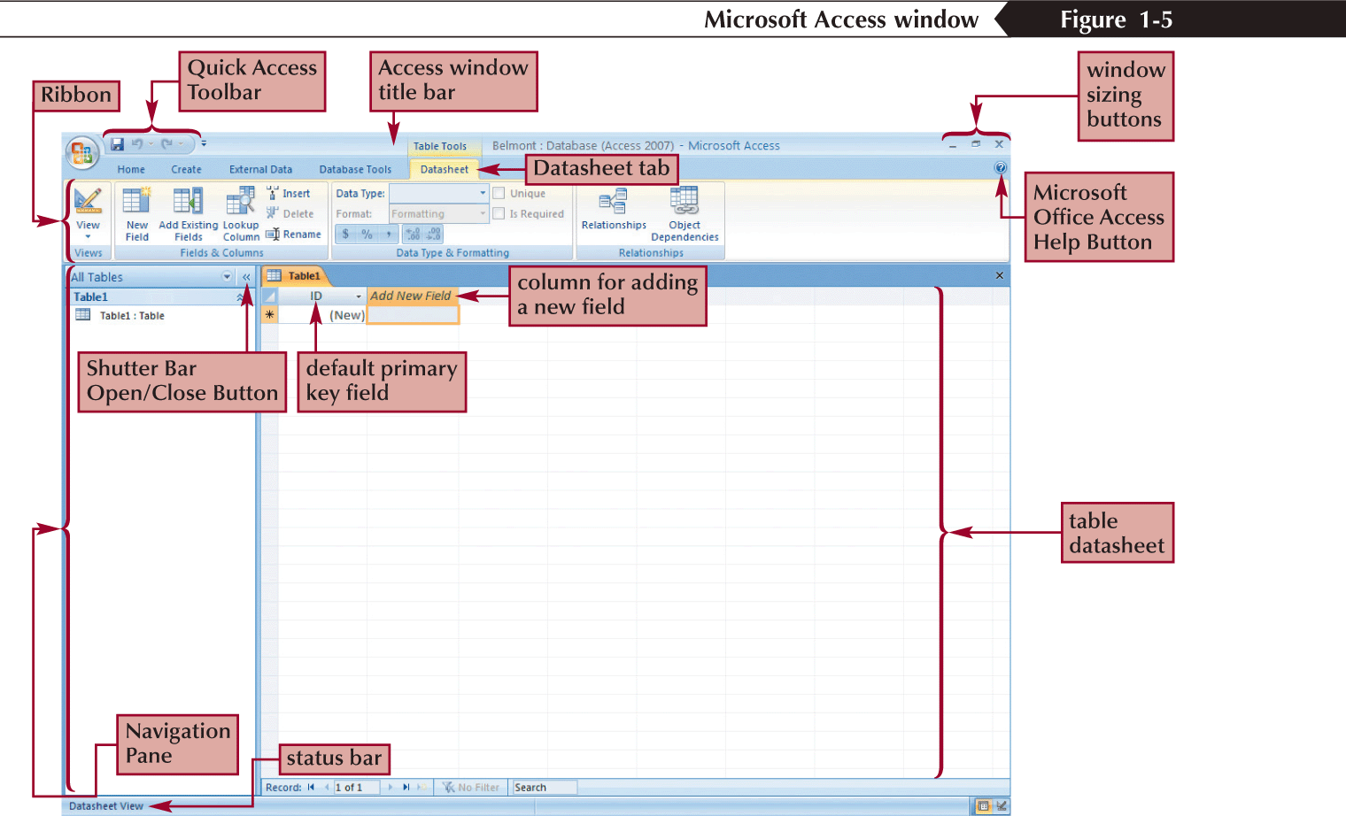
Exploring the
Microsoft Access Window
New Perspectives on Microsoft Office 2007: Windows XP Edition

Slide 9
Creating a Table in Datasheet View
Click the Create tab on the Ribbon
In the Tables group, click the Table button
Accept the default ID primary key field with the AutoNumber data type, or rename the field and change its data type, if necessary
Double-click the Add New Field column heading, and then type the name for the field you are adding to the table
Press the Tab key or the Enter key
New Perspectives on Microsoft Office 2007: Windows XP Edition

Slide 10
Creating a Table in Datasheet View
Add all the fields to your table by typing the field names in the column headings and pressing the Tab key or the Enter key to move to the next column
In the first row below the field names, enter the value for each field in the first record, pressing the Tab key or the Enter key to move from field to field
After entering the value for the last field in the first record, press the Tab key or the Enter key to move to the next row, and then enter the values for the next record. Continue this process until you have entered all the records for the table
Click the Save button on the Quick Access Toolbar, enter a name for the table, and then click the OK button
New Perspectives on Microsoft Office 2007: Windows XP Edition

Slide 11
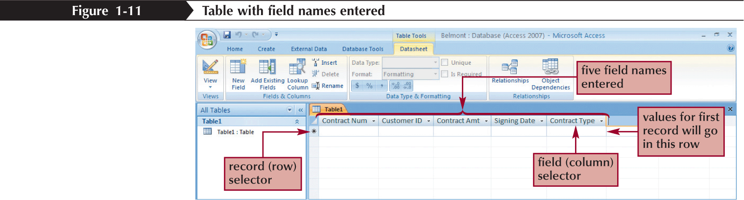
Creating a Table in Datasheet View
New Perspectives on Microsoft Office 2007: Windows XP Edition

Slide 12
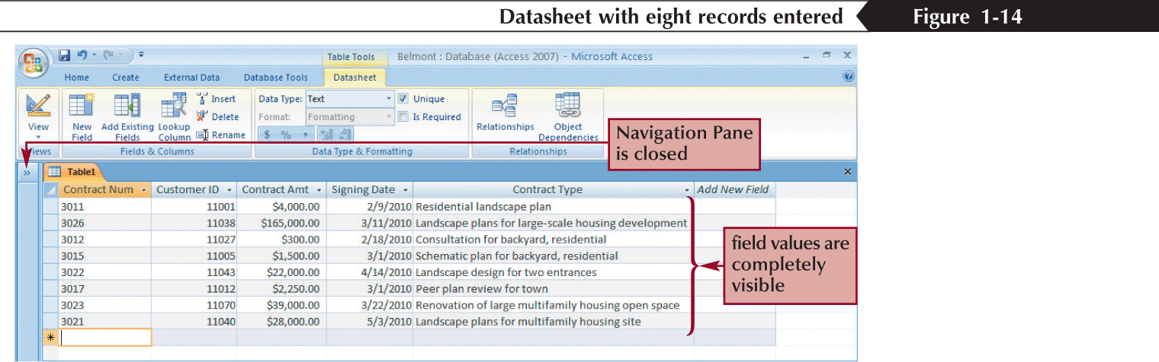
Entering Records
New Perspectives on Microsoft Office 2007: Windows XP Edition

Slide 13
Saving a Table
Click the Save button on the Quick Access Toolbar. The Save As dialog box opens
In the Table Name text box, type the name for the table
Click the OK button
New Perspectives on Microsoft Office 2007: Windows XP Edition

Slide 14
Opening a Database
Start Access and display the Getting Started with Microsoft Office Access page
Click the More option to display the Open dialog box
Navigate to the database file you want to open, and then click the file
Click the Open button
New Perspectives on Microsoft Office 2007: Windows XP Edition

Slide 15
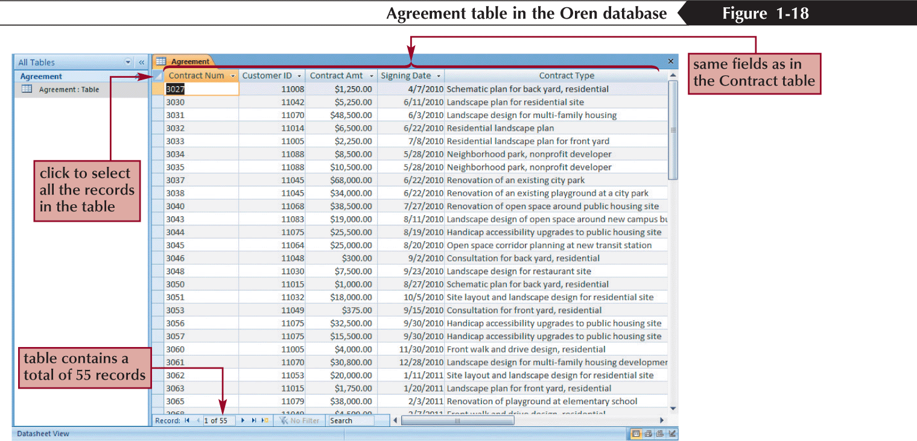
Opening a Database
New Perspectives on Microsoft Office 2007: Windows XP Edition

Slide 16
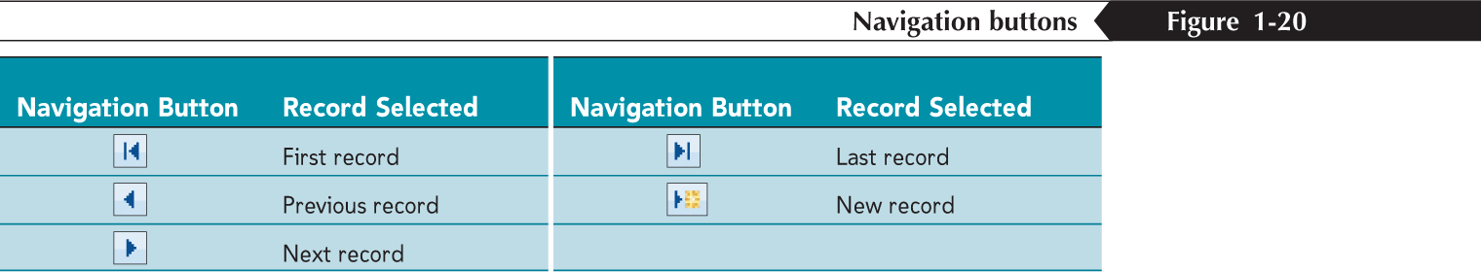
Navigating a Datasheet
The navigation buttons provide another way to move vertically through the records
New Perspectives on Microsoft Office 2007: Windows XP Edition

Slide 17
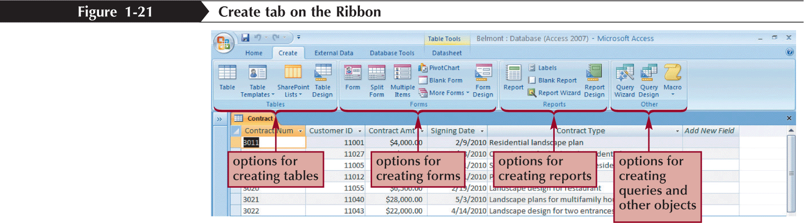
Creating a Simple Query
A query is a question you ask about the data stored in a database
The Simple Query Wizard allows you to select records and fields quickly
New Perspectives on Microsoft Office 2007: Windows XP Edition

Slide 18
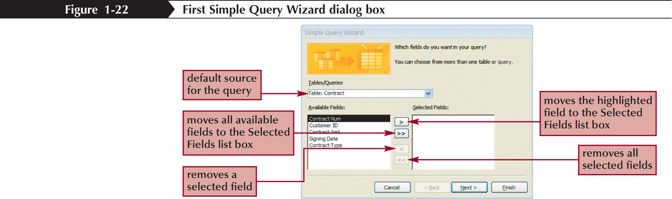
Creating a Simple Query
New Perspectives on Microsoft Office 2007: Windows XP Edition

Slide 19
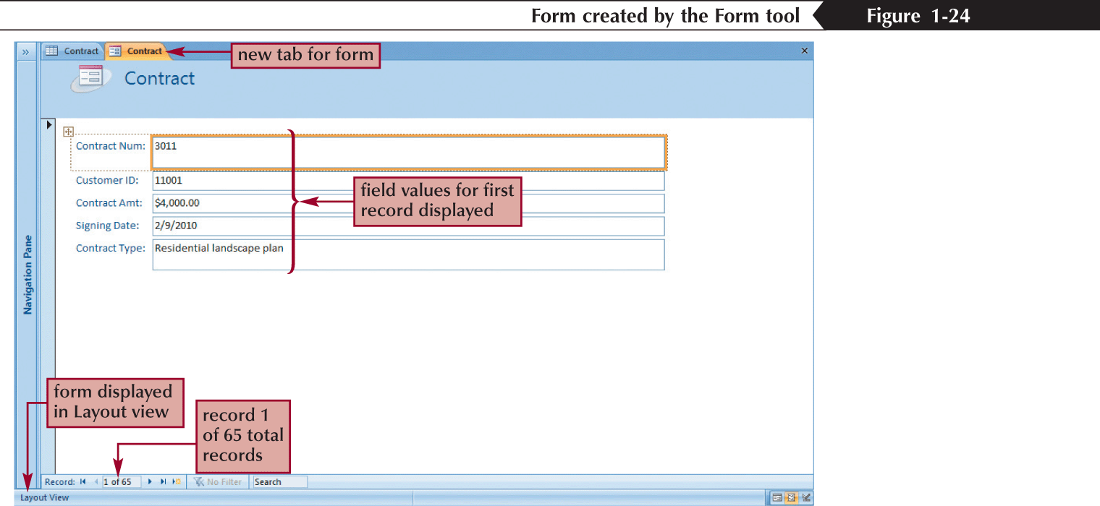
Creating a Simple Form
A form is an object you use to enter, edit, and view records in a database
You can design your own forms, use the Form Wizard, or use the Form tool to create a simple form with one mouse click
New Perspectives on Microsoft Office 2007: Windows XP Edition

Slide 20
Creating a Simple Report
A report is a formatted printout (or screen display) of the contents of one or more tables in a database
The Report tool places all the fields from a selected table (or query) on a report, making it the quickest way to create a report
New Perspectives on Microsoft Office 2007: Windows XP Edition

Slide 21
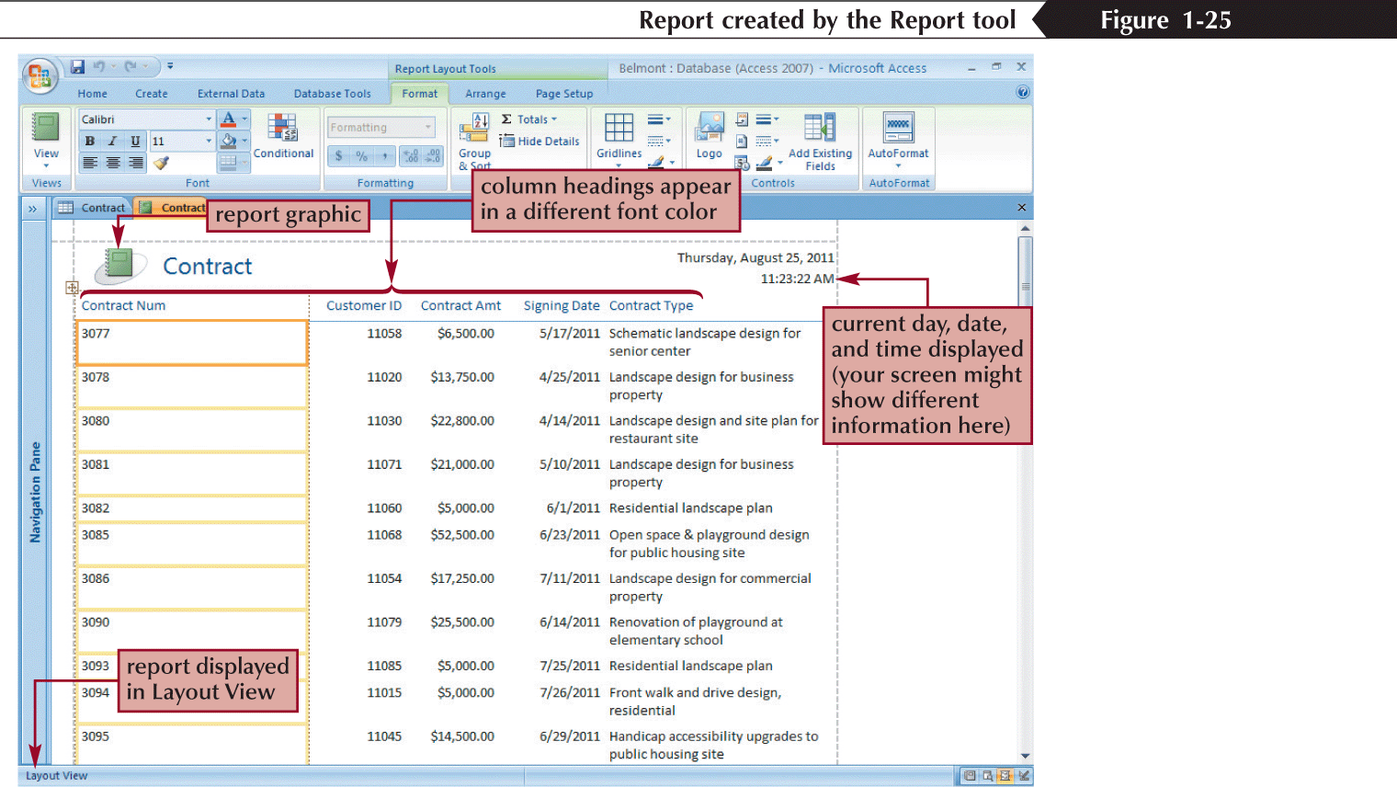
Creating a Simple Report
New Perspectives on Microsoft Office 2007: Windows XP Edition

Slide 22
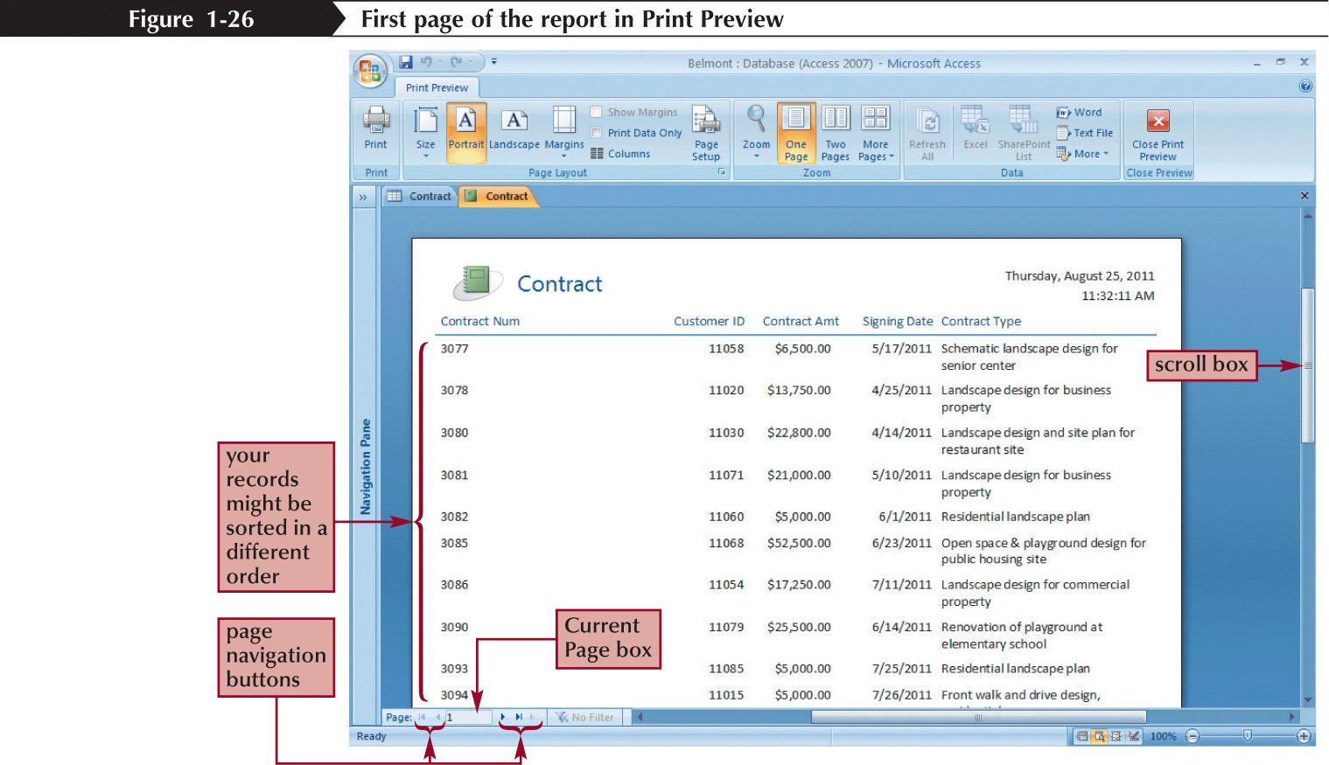
Creating a Simple Report
New Perspectives on Microsoft Office 2007: Windows XP Edition

Slide 23
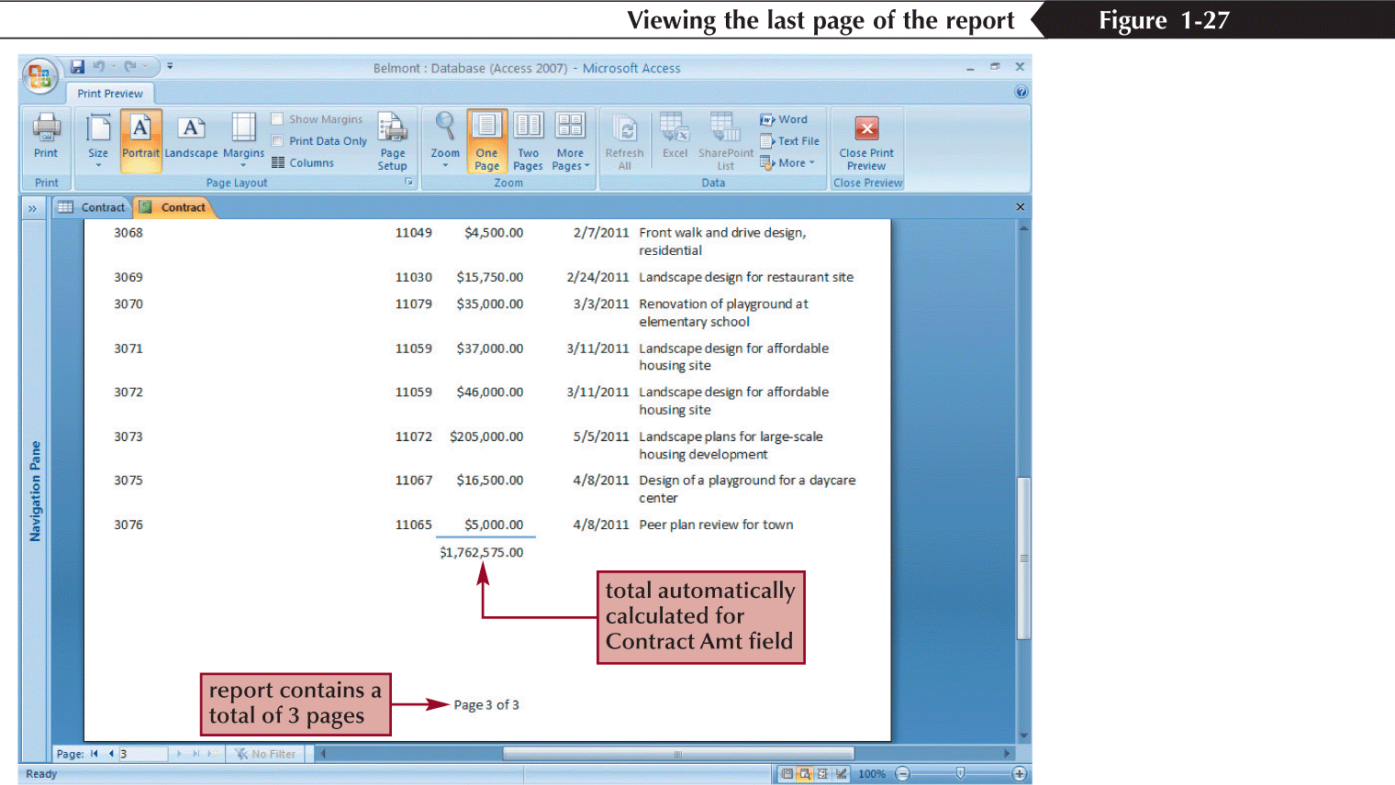
Creating a Simple Report
New Perspectives on Microsoft Office 2007: Windows XP Edition

Slide 24
Printing a Report
Open the report in any view, or select the report in the Navigation Pane
To print the report with the default print settings, click the Office Button, point to Print, and then click Quick Print
or
To display the Print dialog box and select the options you want for printing the report, click the Office Button, point to Print, and then click Print (or, if the report is displayed in Print Preview, click the Print button in the Print group on the Print Preview tab)
New Perspectives on Microsoft Office 2007: Windows XP Edition

Slide 25
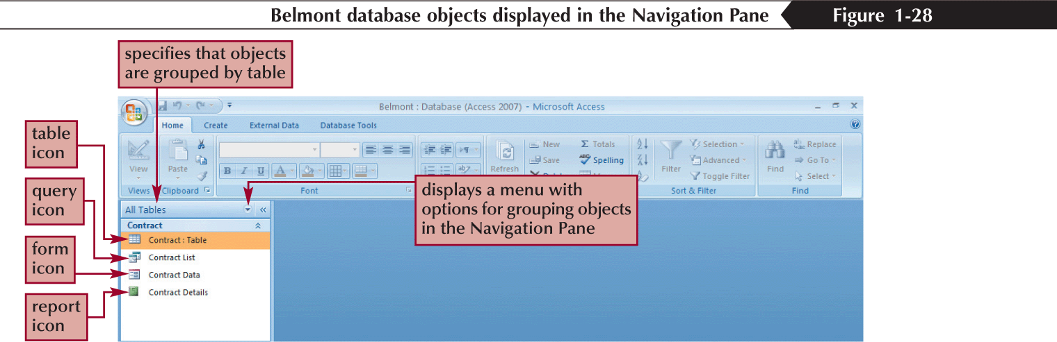
Viewing Objects in the Navigation Pane
New Perspectives on Microsoft Office 2007: Windows XP Edition

Slide 26
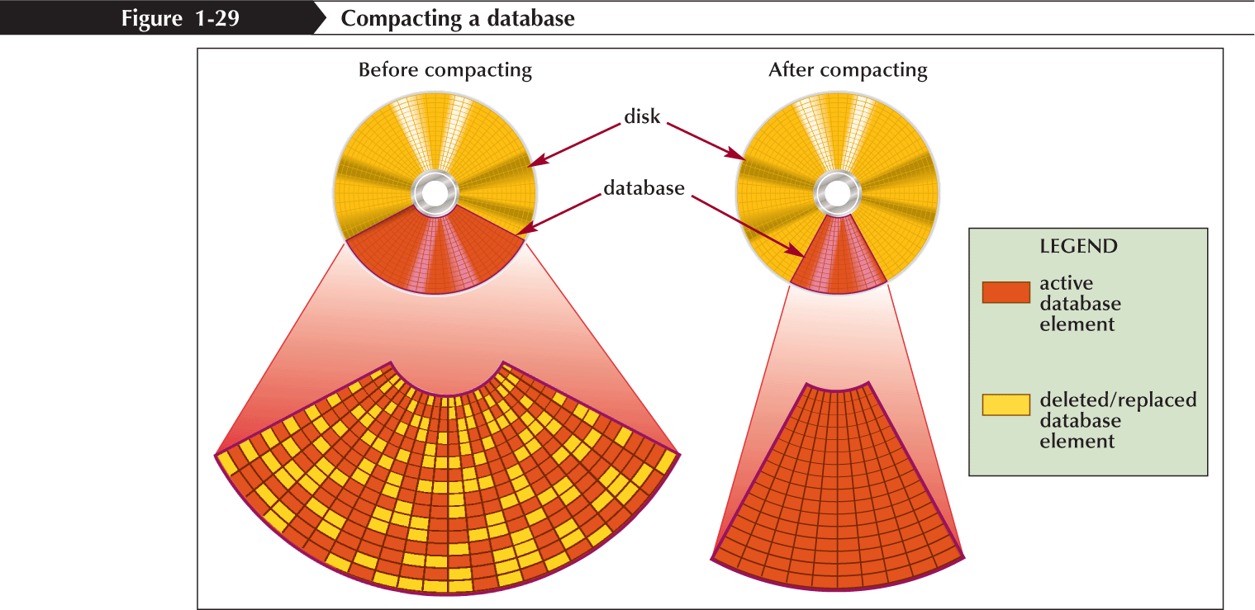
Compacting and Repairing a Database
Compacting a database rearranges the data and objects in a database to decrease its file size
New Perspectives on Microsoft Office 2007: Windows XP Edition

Slide 27
Compacting and Repairing a Database
Make sure the database file you want to compact and repair is open
Click the Office Button, point to Manage, and then click Compact and Repair Database
New Perspectives on Microsoft Office 2007: Windows XP Edition

Slide 28
Backing Up and Restoring a Database
Backing up a database is the process of making a copy of the database file to protect your database against loss or damage
The Back Up Database command enables you to back up your database file from within the Access program, while you are working on your database
To restore a backup database file, you simply copy the backup from the drive on which it is stored to your hard drive
New Perspectives on Microsoft Office 2007: Windows XP Edition

